Slide 1


PLAY
TOCA PARA JUGAR

Slide 2

CUAL ES TU CURSO
3°A O 5°A

Slide 3
BUUUUUUUUUUUUUUUUUUUUUUUUUUUUUUUUUUUUUUUUUUUUUUUUUUUUUUUUUUUUUUUUUUUUUUUUUUUUUUUUUUUUUUUUUUU

Slide 4

KIRBI TE DISE BIEN
ES 5°A

Slide 5

CUANTO ES 16+16
20 O 32

Slide 6

BIEN
BIEN

Slide 7

CUAL ES EL NOMBRE DE TU COLEGIO
TILDA PORTILLO O FLOR DEL INCA

Slide 8
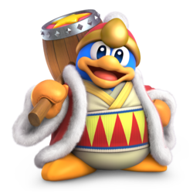
BIEN

